Slide 1
An “Old Perhapser” George Moore’s “Albert Nobbs,” Asexuality, and Trans4Trans Missed Connections
bit.ly/wsgc2024hager
Lisa Hager The University of Wisconsin–Milwaukee at Waukesha hagerl@uwm.edu || they, them, theirs

Slide 2
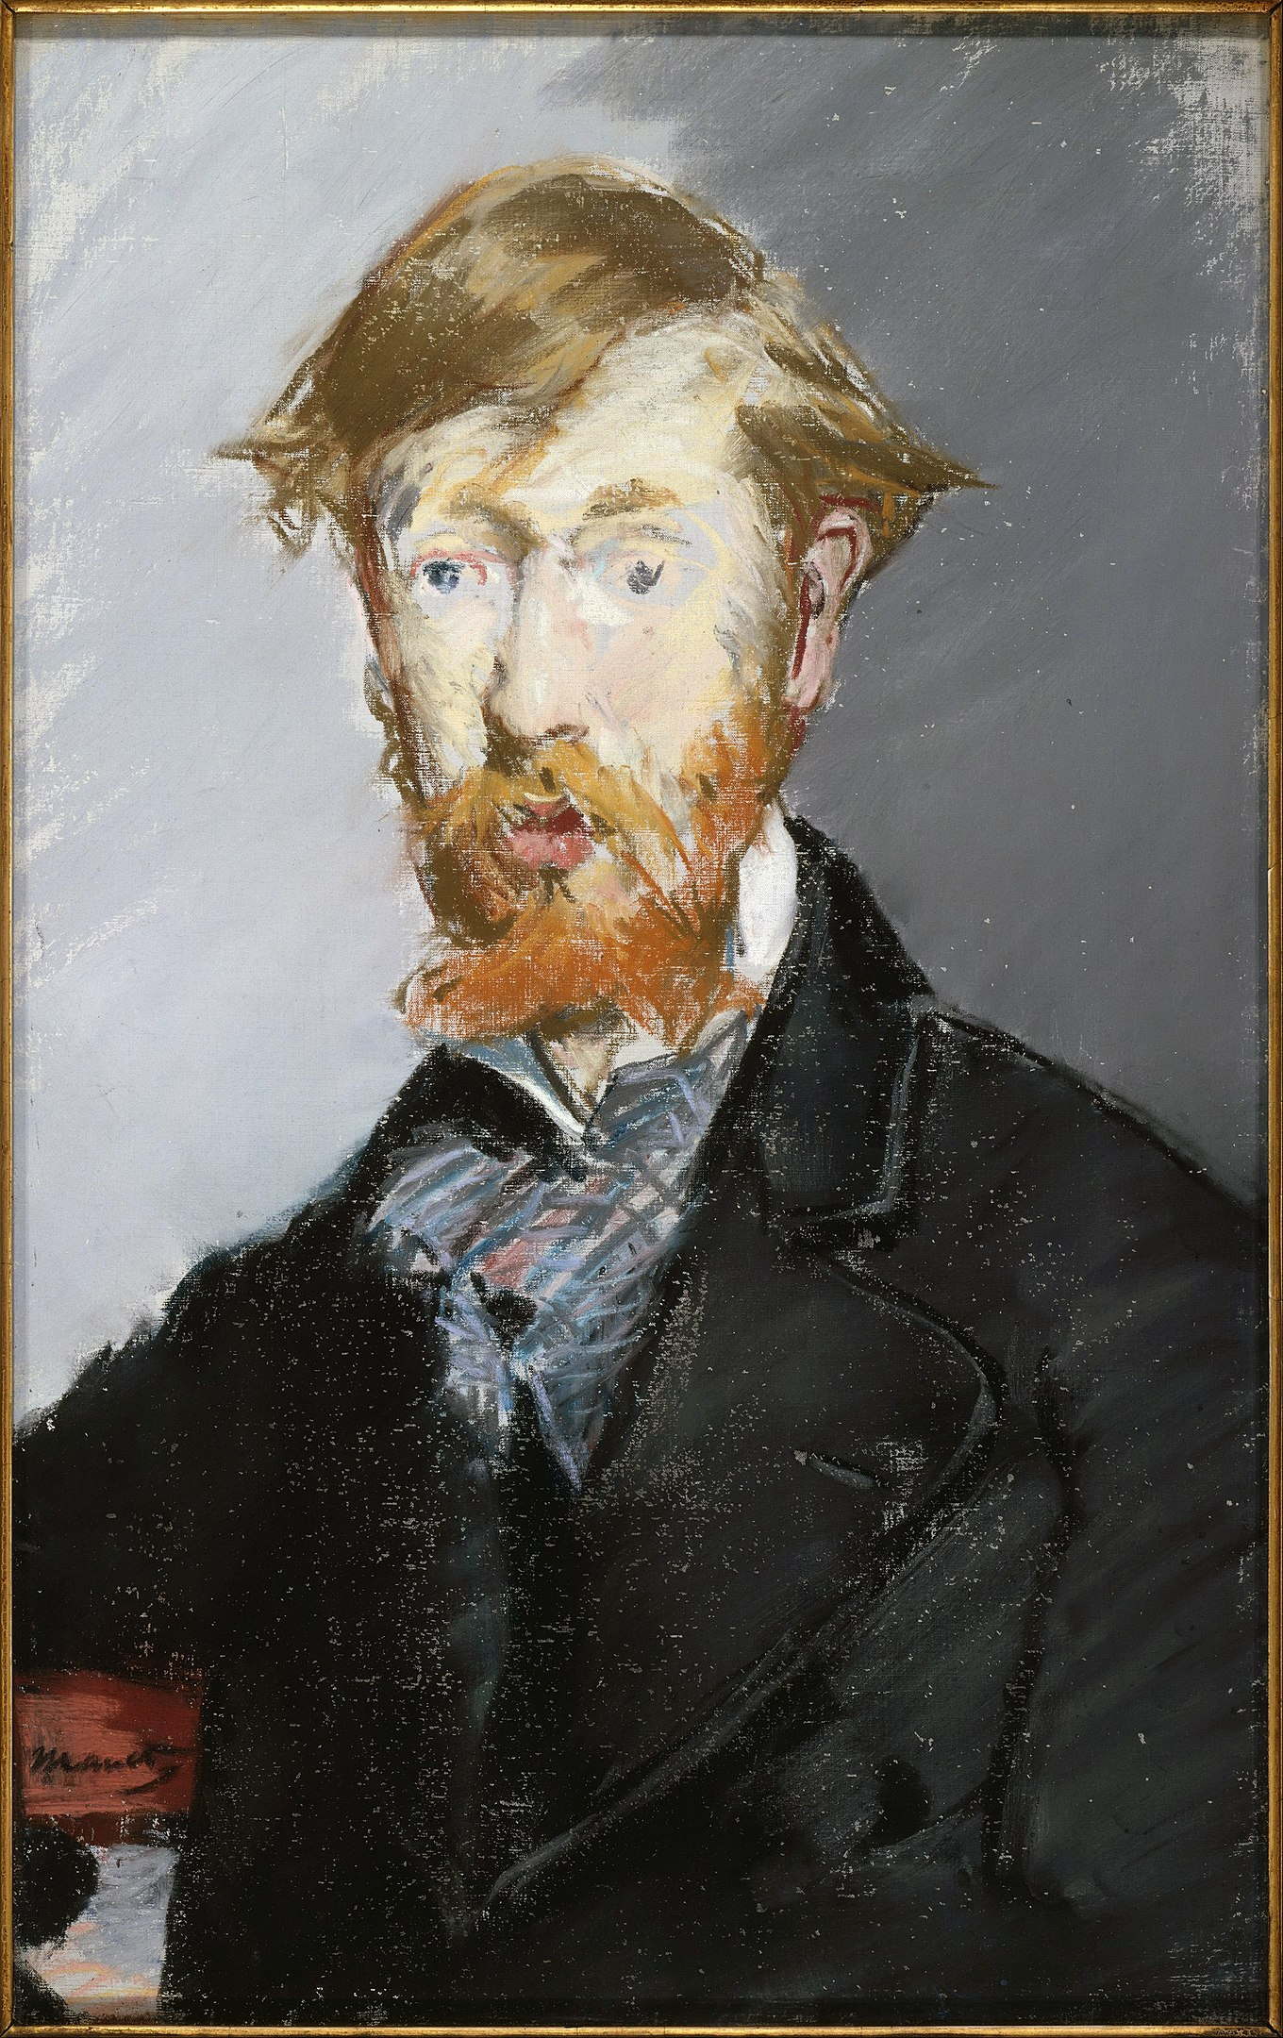
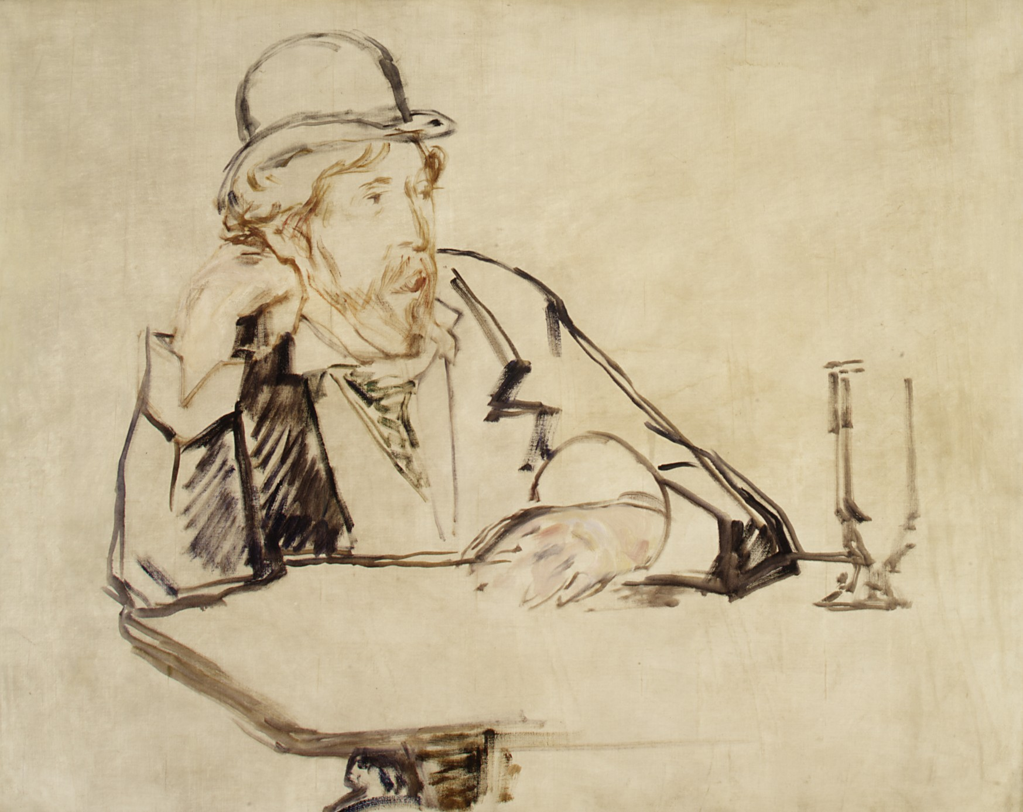
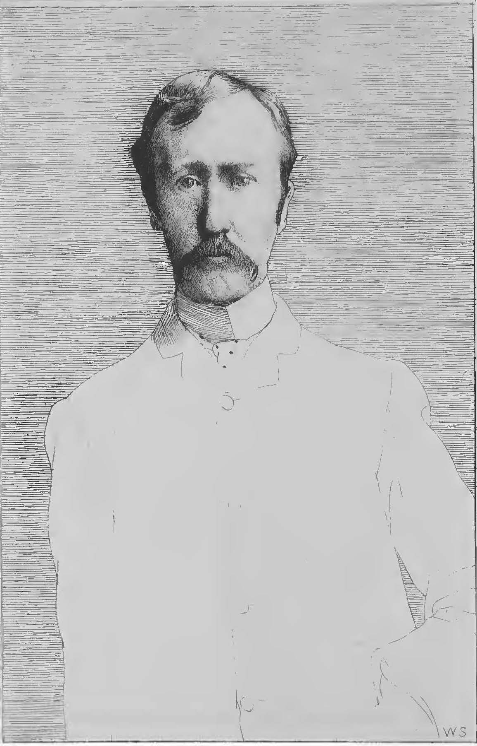
George Moore (1852-1933)
Portrait by Édouard Manet (1879)
George Moore at the Café (de la Nouvelle-Athènes) by Édouard Manet (1878/9)
Portrait from Confessions of a Young Man (1888)

Slide 3
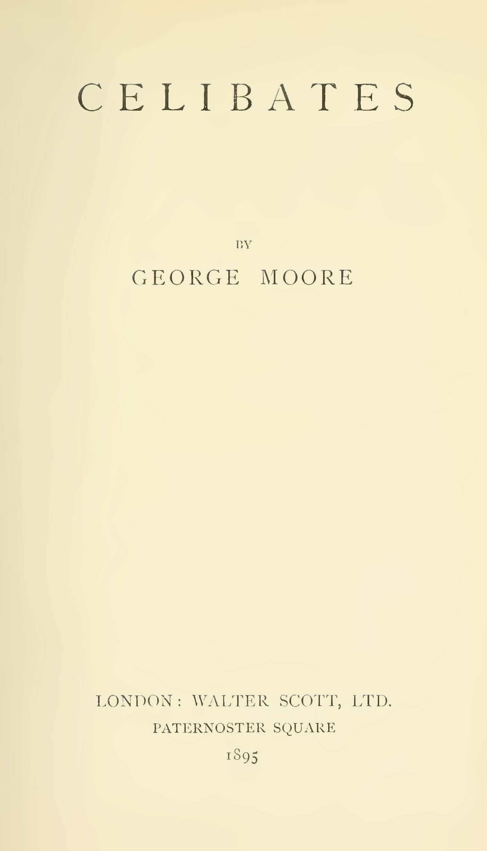
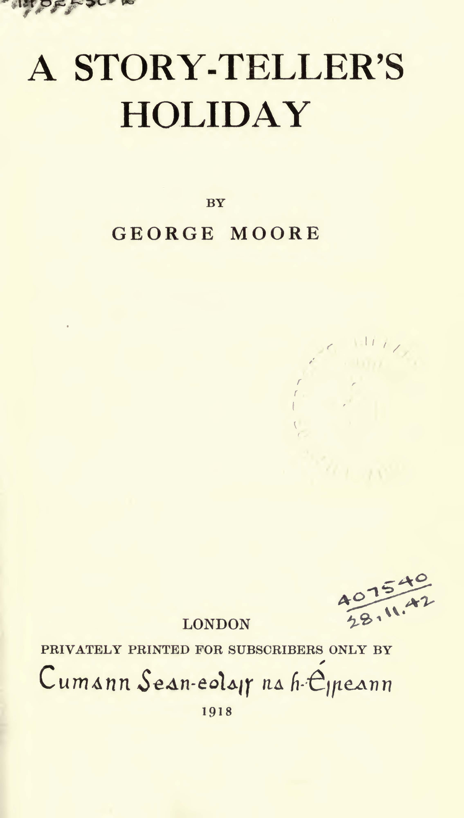
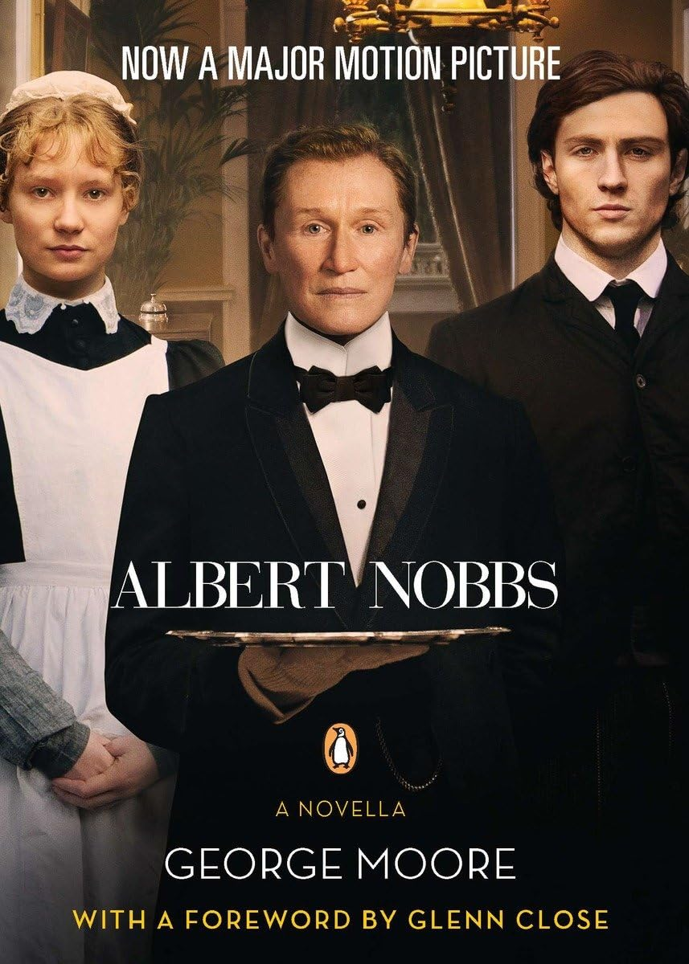
1895
1918
1927
2011

Slide 4
“Albert Nobbs”
I think I was afraid he'd pick me up and kiss me . . . He was a tall, scraggy fellow, with big hips sticking out, and a long, thin throat. It was his throat that frightened me as much as anything about him, unless it was his nose, which was a great high one, or his melancholy eyes, which were pale blue and very small, deep in the head. He was the ugliest thing I’d seen out of a fairy-book
Moore, George. Celibate Lives. William Heinemann Ltd., 1927. pp. 45.

Slide 5
“Albert Nobbs”
Seven years, Page repeated, neither man nor woman, just a perhapser. He spoke these words more to himself than to Nobbs, but feeling he had expressed himself incautiously he raised his eyes and read on Albert’s face that the words had gone home, and that this outcast from both sexes felt her loneliness perhaps more keenly than before.
Moore, George. Celibate Lives. William Heinemann Ltd., 1927. pp. 59.

Slide 6
“Albert Nobbs”
I was as lonely as you, and one day, meeting a girl as lonely as myself, I said: Come along, and we arranged to live together . . . and this I can say with truth, that we haven't known an unhappy hour since we married. . . . I always return to my home after a job is finished with a light heart and leave it with a heavy one.
Moore, George. Celibate Lives. William Heinemann Ltd., 1927. pp. 61.

Slide 7
“Albert Nobbs”
In these parts, Alec said, a woman who left her husband and returned to him after fifteen years would say she was taken away by the fairies whilst wandering in a wood . . . A woman that marries another woman, and lives happily with her, isn’t a natural woman; there must be something of the fairy in her.
Moore, George. Celibate Lives. William Heinemann Ltd., 1927. pp. 96.

